Slide 1
Part 2 Process management
Chapter 4 Threads

Slide 2
Content
Why build threads?
Thread Concept
Multicore Programming
Multithreading Models
Thread Libraries and examples
Operating System Examples

Slide 3
Objectives
To introduce the notion of a thread
To introduce multithreading models
To discuss the APIs for the Pthreads, Win32, and Java thread libraries

Slide 4
1.Why build threads?
Two basic features of process :
  resource allocation
  scheduling

Slide 5
Two basic features
Resource allocation ---When the process starts, it is very expensive to :
    allocate address space
    establish numerous data tables
Scheduling：避免任务长时间占有处理机
提高并发性，需要调度任务小
每次分配资源越多越好，避免频繁分配
每次调度的基本单位越小越好

Slide 6
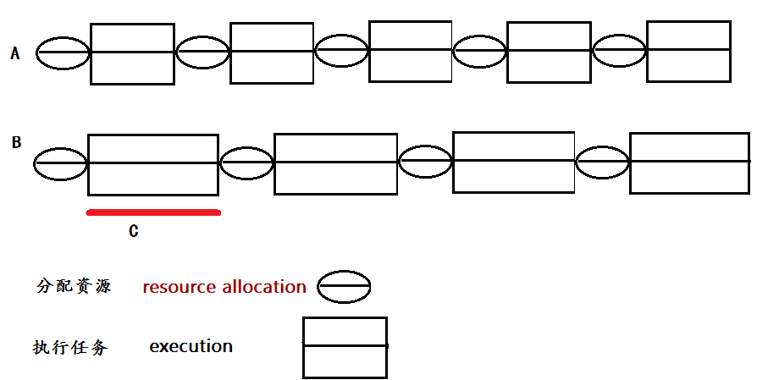
A的相对资源分配时间所占比例多，任务琐碎，CPU使用效率低，可见，分配一次执行任务的资源量不能太少
对于B来说，进程要完成的任务太多了，程序的并发数量减少，并发性较差：执行C的任务时间较长，处理机不能释放，其它进程不能申请到处理机
提高并发性，需要减小调度单位

Slide 7
1.Why build threads?
Main idea :
  Separate the allocation and scheduling of the process resource
  The concept of threads is introduced.
目的：
  一次性分配充足资源-----避免频繁分配资源
  降低调度单位，提高并发性

Slide 8
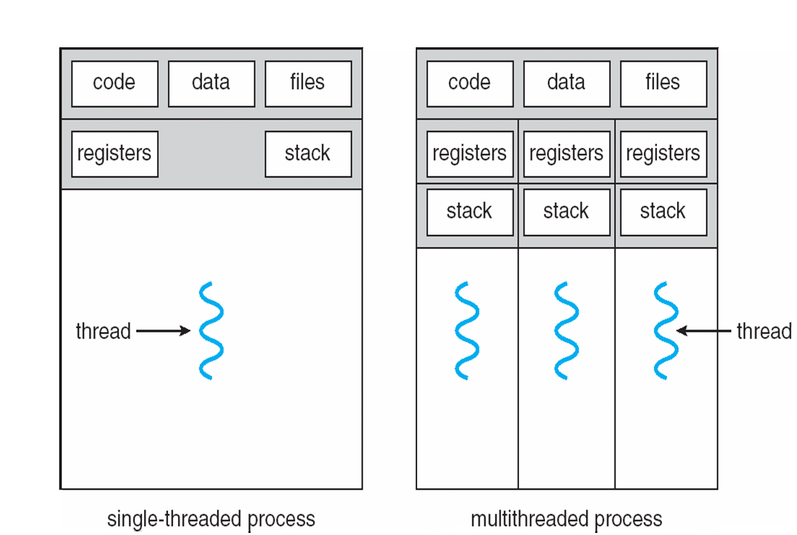
Single and Multithreaded Processes

Slide 9
1.Why build threads?
(1)From the view of point of cost(开销) :
Threads of a process can use the same address space between each other:
  share most of the data
  it takes less space to start a thread than process
The time required for switching threads is far less than that of process

Slide 10
1.Why build threads?
(2)From the view of point of communication:
  It is time-consuming and not convenient in communication between different processes
  Sharing data between threads of same process can be convenient and efficient, communication is not necessary

Slide 11
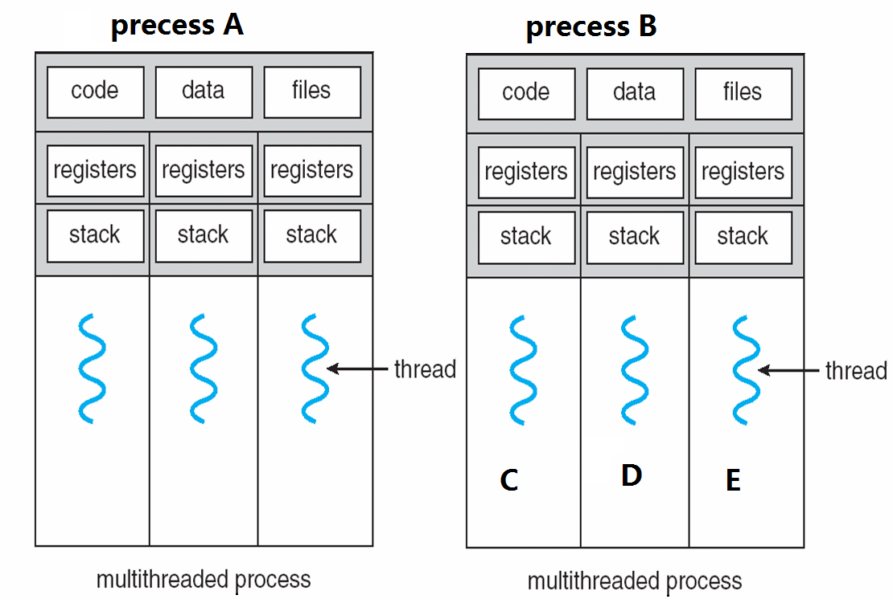
Example-- Single and Multithreaded Processes
Precess A and B use different data address(PCB)
Thread C, D and E share the data , it is not necessary to deal with the problem of communication (convenient and efficient )

Slide 12
Why build threads?
Threads
  It needs less time to create new thread and end a thread.
  It needs less time to switch threads
  Memory and files are shared within threads in the same process, it is not necessary to call the kernel in communicate
  Threads can be used in multi-processor systems

Slide 13
Motivation of multithreaded
Most modern applications are multithreaded
Threads run within application
Multiple tasks with the application can be implemented by separate threads
  Update display
  Fetch data
  Spell checking
  Answer a network request
Process creation is heavy-weight while thread creation is light-weight
Can simplify code, increase efficiency
Kernels are generally multithreaded

Slide 14
Benefits
Responsiveness – may allow continued execution if part of process is blocked, especially important for user interfaces
Resource Sharing – threads share resources of process, easier than shared memory or message passing
Economy – cheaper than process creation, thread switching lower overhead than context switching
Scalability – process can take advantage of multiprocessor architectures

Slide 15
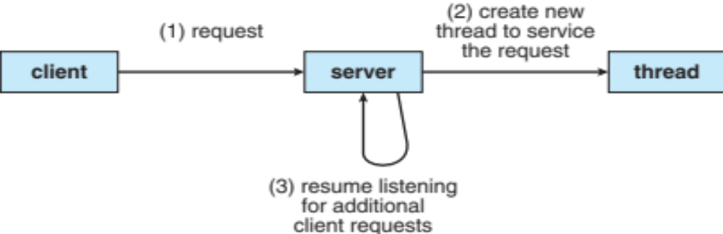
Multithread example
Multithreaded Server Architecture

Slide 16
2.Thread Concept
线程定义
  线程
  有时称轻量进程
  进程中的一个运行实体
  是一个CPU调度单位
  资源的拥有者是进程或称任务
  可由内核控制，也可由用户控制
  也描述为：
  进程的执行体、一个执行单元、进程内的一个可调度实体等。

Slide 17
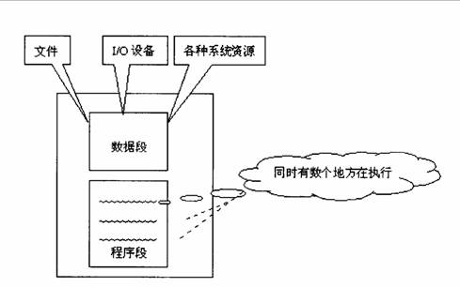
2.Thread Concept

Slide 18
2.Thread Concept -----线程组成
基本上不拥有系统资源，存取所在进程的内存和其他资源
只包含一些如程序计数器、寄存器和一组栈
TCB（线程控制块）
不运行时保存上下文

Slide 19
Thread: What?
States shared by all threads in a process/address space
  contents of memory (global variables, heap)‏
  I/O state
State private to each thread
  CPU registers (and PC)‏
  Execution stack: for parameters, temporary variables, and return PCs
  Stored in Thread Control Block (TCB)‏

Slide 20
Process-thread relationship classification
one address space
multiple address spaces
one thread/as
DOS, early Macintosh
traditional Unix
multiple
thread/as
embedded systems
java os
pilot
mach, os/2, linux
windows 9x
windows nt (xp, vista, ...)‏
modern unix: solaris, hp-ux, ...
Notes:
线程主要用于多处理器系统以及网络系统的操作系统中

Slide 21
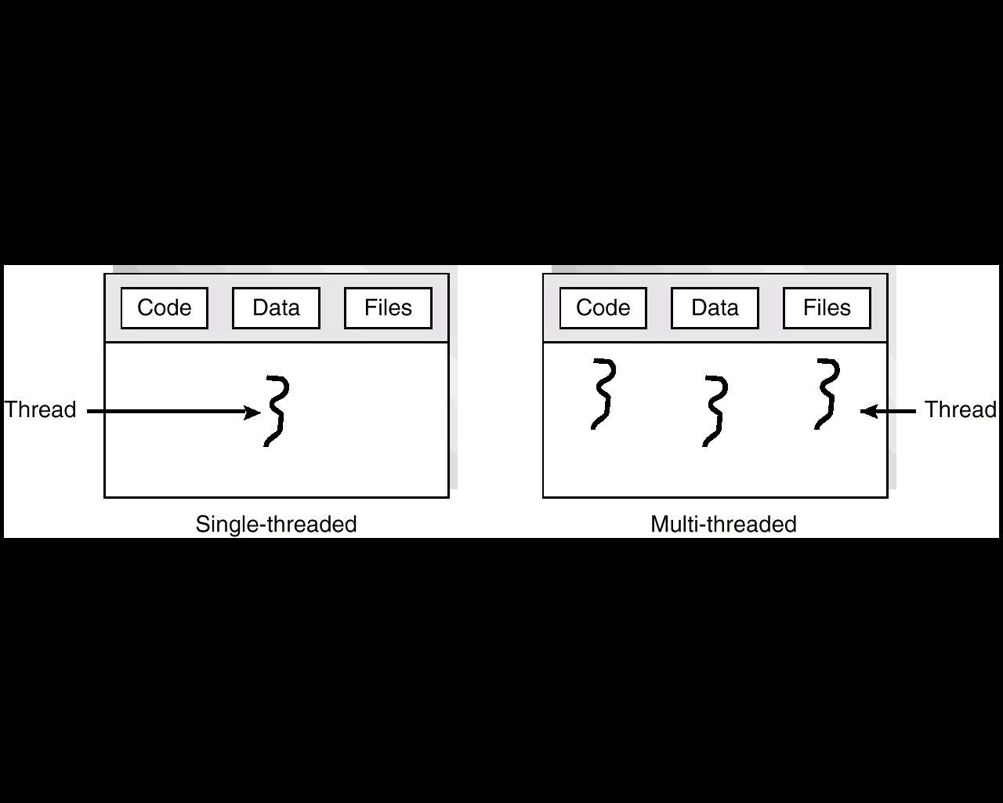

Slide 22
线程控制块TCB: Look closer
Execution state: CPU registers, PC, pointer to stack
Scheduling information: state, priority, CPU time
Accounting information
Various pointers to queues
Notes:
一般 TCB 中的内容较少，因为有关资源分配等多数信息已经记录于所属进程的 PCB中．TCB中的主要信息包括： 线程标识、线程状态、调度参数、现场、链接指针 ，其中现场信息主要包括通用寄存器、指令计数器 PC以及用户栈指针．对于操作系统支持的线程，TCB中还应包含系统栈指针。

Slide 23
2.Thread Concept -----线程状态
新建状态(New)：新创建一个线程对象。
就绪状态(Ready)：
  位于可运行线程池中，变得可运行，等待获取CPU的使用权 。
运行状态(Running)：
  就绪状态的线程获取了CPU ，执行程序代码
阻塞状态(Blocked，Waiting)：
  因为某种原因放弃CPU使用权，暂时停止运行 ，直到线程进入就绪状态。阻塞有等待阻塞、同步阻塞等。

Slide 24
Thread scheduling
new
terminated
ready
running
waiting

Slide 25
Thread dispatching
Loop {
RunThread();
ChooseNextThread();
SaveStateOfCPU (curTCB);
LoadStateOfCPU (newTCB);
}

Slide 26
Start to run a thread
Internal events:
  Blocking on I/O
  Waiting on a signal from other thread
  Thread executes a yield()‏
External ones: preemptive
  Interrupts
  Timer
When?
  Dispatcher chooses it
    Because of internal events, or
    External events
How?
  Load the state into CPU
  Load environment (address space etc.)‏
  Jump to PC
Notes:
Yield()作用：暂停当前正在执行的线程对象，并执行其他线程。

Slide 27
3. Multicore Programming
Multicore or multiprocessor systems putting pressure on programmers, challenges include:
  Dividing activities
  Balance
  Data splitting
  Data dependency
  Testing and debugging
Parallelism implies a system can perform more than one task simultaneously
Concurrency supports more than one task making progress
  Single processor / core, scheduler providing concurrency

Slide 28
Multicore Programming (Cont.)
Types of parallelism
  Data parallelism – distributes subsets of the same data across multiple cores, same operation on each
  Task parallelism – distributing threads across cores, each thread performing unique operation
As # of threads grows, so does architectural support for threading
  CPUs have cores as well as hardware threads
  Consider Oracle SPARC T4 with 8 cores, and 8 hardware threads per core

Slide 29
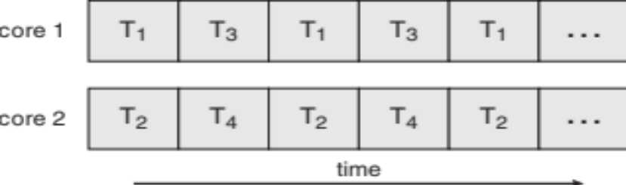
Concurrency vs. Parallelism
Concurrent execution on single-core system:
Parallelism on a multi-core system:

Slide 30
3.Multithreading Models
用户级线程
内核级线程
两者结合方法

Slide 31
User Threads and Kernel Threads
User threads - management done by user-level threads library
Three primary thread libraries:
  POSIX Pthreads
  Windows threads
  Java threads
Kernel threads - Supported by the Kernel
Examples – virtually all general purpose operating systems, including:
  Windows
  Solaris
  Linux
  Tru64 UNIX
  Mac OS X

Slide 32
（1）用户级线程
用户级线程仅存在于用户空间中。
对于这种线程的创建、 撤消、线程之间的同步与通信等功能，都无须利用系统调用来实现。
对于用户级线程的切换，通常是发生在一个应用进程的各个多线程之间，这时，也同样无须内核的管理。
由于切换的规则远比进程调度和切换的规则简单，因而使线程的切换速度特别快。
可见，这种线程是与内核无关的

Slide 33

（1）用户级线程
优点
  线程切换不调用内核
  调度是应用程序特定的：可以选择最好的算法
  可运行在任何操作系统上（只需要线程库）

Slide 34

（1）用户级线程
缺点
  在一个典型的操作系统中，可能会有许多系统调用引起阻塞，而当该线程执行一次系统调用时，就阻塞本身和正等待的所有线程；
  核心只将处理器分配给进程，同一进程中的两个线程不能同时运行于两个处理器上
  本方法只适合单CPU，无法同时运行多核CPU。

Slide 35
（2）内核级线程
内核级线程：线程的所有操作都由内核控制
优点
  可调度一个进程中的多个线程，可同时在多核CPU上运行；
  当其中一个线程被阻塞时，不影响其它线程的运行；
  内核本身可以以线程方式实现多处理器的处理功能，内核可以同时调度同一进程的多个线程
  阻塞是在线程一级完成
  内核例程是多线程的

Slide 36
（2）内核级线程
缺点：
  线程调度在内核态下运行，应用程序在用户态下运行
  控制过程中需要内核态和用户态的两次模式切换
  同一进程内的线程切换调用内核，导致速度下降

Slide 37
Multithreading Models
Many-to-One Model
One-to-One Model
Many-to-Many Model
Notes:
有些系统同时支持用户线程和内核线程，由此产生了不同的多线程模型。

Slide 38
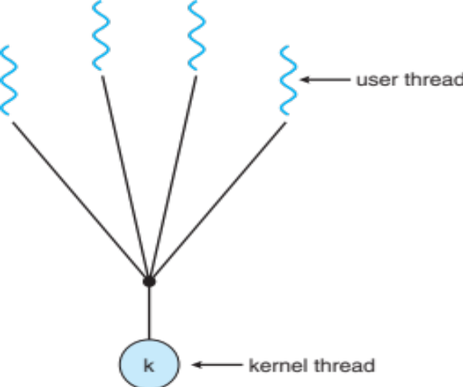
（a）Many-to-One model
Many-to-One
  Many User-Level Threads Mapped to Single Kernel Thread.
  Used on Systems That Do Not Support Kernel Threads.
Multiple threads may not run in parallel on muticore system because only one may be in kernel at a time
Few systems currently use this model
Examples:
  Solaris Green Threads
  GNU Portable Threads
Notes:
线程管理在用户空间完成，所以它的效率比较高。但是如果一个线程调用了导致阻塞的系统调用的话，那么将阻塞整个进程。而且，因为一次只有一个线程可以访问内核，所以在多处理机环境中多个线程不能够并发执行。不支持内核级线程的操作系统上所实现的用户线程库也使用多对一模型。

Slide 39
Many-to-One model
线程管理在用户空间完成，所以它的效率比较高。
如果一个线程调用了导致阻塞的系统调用的话，那么将阻塞整个进程。
一次只有一个线程可以访问内核，所以在多处理机环境中多个线程不能够并发执行。
不支持内核级线程的操作系统上所实现的用户线程库也使用多对一模型。

Slide 40
（b）One-to-One model
Each User-Level Thread Maps to Kernel Thread.
Examples
  Windows 95/98/NT
  OS/2
  Linux
  Solaris 9 and later
Notes:
它允许在一个线程调用导致阻塞的系统调用的情况下持续运行其它的线程，从而提供了比多对一模型更好的并发性；它也允许多个线程在多处理机环境中并行执行。这种模型的唯一缺点在于创建一个用户线程就需要创建一个相应的内核线程。因为创建内核线程的开销会加重应用程序的负担，所以这种模型的大多数实现都要限制系统支持的线程数量。

Slide 41

One-to-one Model

Slide 42
它允许在一个线程调用系统调用导致阻塞的情况下,持续运行其它的线程，从而提供了比多对一模型更好的并发性
允许多个线程在多处理机环境中并行执行。
缺点：创建一个用户线程就需要创建一个相应的内核线程。因为创建内核线程的开销会加重应用程序的负担，所以这种模型实现多数都要限制系统支持的线程数量。

Slide 43
（c）Many-to-Many model
Many-to-Many
Examples
  Solaris Threads
  Java Threads

Slide 44

Many-to-Many

Slide 45
各种模型说明
多对多模型将用户级线程多路映射到内核线程，映射的内核线程数量可以与之相等或更少。
内核线程的数量由具体的应用程序或具体的机器确定（在多处理机中，内核线程分配的数量可能更多一些）
多对一模型允许开发者创建任意多个用户线程。但是，因为内核一次只能调度一个线程，所以并不能获得真正的并行性。
Notes:
多对多模型将用户级线程多路复用到与之数量相等或少一点的内核线程。内核线程的数量由具体的应用程序或具体的机器确定（分配给应用程序的内核线程数量在多处理机环境中可能比单处理机环境中多）。然而，多对一模型允许开发者随心所欲的创建用户线程。但是，因为内核一次只能调度一个线程，所以并不能获得真正的并行性。
一对一模型允许更大的并行性，但是开发者必须小心，以免在一个程序中创建过多的线程（而且在某些情况下可能会限制开发者能够创建的线程的数目）。
多对多模型则免却了所有这些缺点：开发者能够创建所需的用户线程，而且相应的内核线程能够在多处理机环境中并行运行。而且当一个线程执行导致阻塞的系统调用时，内核能够调度其它的线程执行。

Slide 46
各种模型说明（continue)
一对一模型允许更大的并行性，但是开发者必须小心，以免在一个程序中创建过多的线程，而且在某些情况下可能会限制开发者能够创建的线程的数目。
多对多模型则避免了所有这些缺点：开发者能够创建所需的用户线程，而且相应的内核线程能够在多处理机环境中并行运行。而且当一个线程执行导致阻塞的系统调用时，内核能够调度其它的线程执行。

Slide 47

Two layer
User thread vs. kernel thread
  two layer
Similar to M:M, except that it allows a user thread to be bound to kernel thread
Examples
  IRIX
  HP-UX
  Tru64 UNIX
  Solaris 8 and earlier

Slide 48
two layer
u
u
u
u
u
u
u
u
L
L
L
L
L
k
k
k
k
k
thread scheduler
CPU
CPU

Slide 49

Solaris 2 Threads

Slide 50
Lightweight Process
轻量级进程（LWP）
  是一种实现多任务的方法。与普通进程相比，LWP与其他进程共享所有（或大部分）它的逻辑地址空间和系统资源
  与线程相比，LWP有它自己的进程标识符，优先级，状态，以及栈和局部存储区，并和其他进程有着父子关系；
  LWP的一个重要作用是提供了一个用户级线程实现的中间系统。LWP可以通过系统调用获得内核提供的服务，因此，当一个用户级线程运行时，只需要将它连接到一个LWP上便可以具有内核支持线程的所有属性。

Slide 51
4.Thread Libraries
Thread library provides programmer with API for creating and managing threads
Two primary ways of implementing
  Library entirely in user space
  Kernel-level library supported by the OS

Slide 52
在过去，产品提供商会提供线程的硬件专用版本。这些线程的实现彼此会有很大的差异，所以会使得程序员开发可移植的线程应用程序非常困难。
为了充分利用线程的特性，需要一个标准的线程编程接口

Slide 53
对于UNIX系统，这个接口已经被IEEE POSIX 1003.1c标准（1995）所指定
这套标准的实现被称为POSIX threads，或者Pthreads
现在大部分的硬件提供商都提供他们专有的API之外，还会有Pthreads库
POSIX标准在不停的进化和修改，包括Pthreads的规范。它的最新版本是IEEE Std 1003.1,2004版本

Slide 54
(1)Pthreads
May be provided either as user-level or kernel-level
A POSIX standard (IEEE 1003.1c) API for thread creation and synchronization
API specifies behavior of the thread library, implementation is up to development of the library
Common in UNIX operating systems (Solaris, Linux, Mac OS X)

Slide 55
(2)Win32 API thread Example1: 创建一个线程
#include <windows.h>
DWORD WINAPI threadFunc (LPVOIDpArg)
{ return 0; }
main ()
{ HANDLE hThread;
hThread = CreateThread (NULL, 0, threadFunc, NULL, 0, NULL );
return 0; }
上面代码threadFunc 有可能不会被执行到就结束了！要保证 threadFunc 肯定被执行（也就是等线程退出），在 CreateThread 后加一行代码：
WaitForMultipleObjects (1, &hThread, TRUE, INFINITE);

Slide 56
WaitForMultipleObjects
DWORD WaitForMultipleObjects(
DWORD nCount, // number of handles in the object handle array
CONST HANDLE *lpHandles, // pointer to the object-handle array
BOOL bWaitAll, // wait flag
DWORD dwMilliseconds // time-out interval in milliseconds
);

Slide 57
Win32 API thread
Example2: 4个线程一起运行
int main()
{
HANDLE hThread[numThreads];
int threadNum[numThreads];
for(inti=0; i<numThreads; i++)
{
threadNum[i] = i;
hThread[i] = CreateThread(NULL, 0, threadFunc, &threadNum[i], 0, NULL);
}
WaitForMultipleObjects(numThreads, hThread, TRUE, INFINITE);
return 0;
}
#include <Windows.h>
#include <stdio.h>
const int numThreads = 4;
DWORD WINAPI threadFunc(LPVOIDpArg)
{
int *p = (int *)pArg;
int num = *p;
printf("threadFunc...%d...\n", num);
return 0;
}

Slide 58
(3) linux C pthread多线程API函数
POSIX thread 简称为pthread
Posix线程是一个POSIX标准线程.
该标准定义内部API创建和操纵线程.
POSIX线程标准通常称为pthreads.
pthreads是最常用的POSIX系统如Linux和Unix
而微软的Windowsimplementations同时存在.
pthreads-w32可支持MIDP（Mobile Information Device Profile）的pthread
Pthreads定义了一套 C程序语言类型、函数与常量，它以 pthread.h 头文件和一个线程库实现。

Slide 59
(3) linux C pthread多线程API函数
创建线程:
int pthread_create(
pthread_t *tid //指向存储线程ID的一个变量地址
, const pthread_attr_t *attr //线程属性，如果为NULL的使用默认属性
, void*(*start_routine)(void*) //线程执行函数
,void *arg //线程函数参数
);
线程创建成功后进入就绪态。
线程退出:
void pthread_exit(
void* value_ptr // value_ptr 是一个指向返回状态值的指针。
);

Slide 60
(3) linux C pthread多线程API函数
等待线程退出
int pthread_join(
pthread_t tid , //线程ID
void **status //存放线程返回值的指针
);
分离线程，使线程运行完后自动释放资源
pthread_detach( pthread_t tid );

Slide 61
(4)Java Threads
Java threads are managed by the JVM
Typically implemented using the threads model provided by underlying OS
Java threads may be created by:
  Extending Thread class
  Implementing the Runnable interface

Slide 62

(4)Java Threads
Create the Thread
Java Thread Management

Slide 63
(4)Java Threads
由于Java是纯面向对象语言，Java的线程模型也是面向对象的。
Java通过Thread类将线程所必须的功能都封装了起来。
要想建立一个线程，必须要有一个线程执行函数，这个线程执行函数对应Thread类的run方法。
Thread类还有一个start方法，这个方法负责建立线程，相当于调用Windows的建立线程函数CreateThread.
当调用start方法后，如果线程建立成功，并自动调用Thread类的run方法。
通过Thread类的start方法来建立线程。

Slide 64
Create the Thread
class Worker1 extends Thread
{
public void run() {
System.out.println(“I am a Worker Thread”);
}
}

Slide 65
Create the Thread
public class First
{
public static void main(String args[]) {
Worker runner = new Worker1();
runner.start();
System.out.println(“I am the main thread”);
}
}

Slide 66
Create the Thread
public interface Runnable
{
public abstract void run();
}

Slide 67
Create the Thread
class Worker2 implements Runnable
{
public void run() {
System.out.println(“I am a Worker Thread”);
}
}

Slide 68
Create the Thread
public class Second
{
public static void main(String args[]) {
Runnable runner = new Worker2();
Thread thrd = new Thread(runner);
thrd.start();
System.out.println(“I am the main thread”);
}
}

Slide 69
Java Thread Management
suspend() – suspends execution of the currently running thread.
sleep() – puts the currently running thread to sleep for a specified amount of time.
resume() – resumes execution of a suspended thread.
stop() – stops execution of a thread.

Slide 70
Operating System Examples
Windows Threads
Linux Threads

Slide 71
Windows Threads
Windows implements the Windows API – primary API for Win 98, Win NT, Win 2000, Win XP, and Win 7
Implements the one-to-one mapping, kernel-level
Each thread contains
  A thread id
  Register set representing state of processor
  Separate user and kernel stacks for when thread runs in user mode or kernel mode
  Private data storage area used by run-time libraries and dynamic link libraries (DLLs)
The register set, stacks, and private storage area are known as the context of the thread

Slide 72
Windows Threads (Cont.)
The primary data structures of a thread include:
  ETHREAD (executive thread block) – includes pointer to process to which thread belongs and to KTHREAD, in kernel space
  KTHREAD (kernel thread block) – scheduling and synchronization info, kernel-mode stack, pointer to TEB, in kernel space
  TEB (thread environment block) – thread id, user-mode stack, thread-local storage, in user space

Slide 73

Windows Threads Data Structures

Slide 74
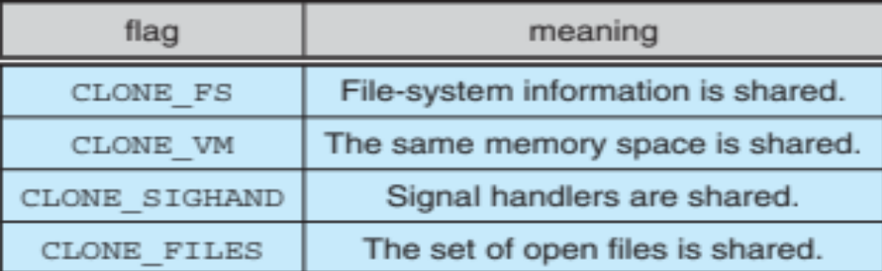
Linux Threads
Linux refers to them as tasks rather than threads
Thread creation is done through clone() system call
clone() allows a child task to share the address space of the parent task (process)
  Flags control behavior
struct task_struct points to process data structures (shared or unique)

Slide 75
Homework
assignment4

Slide 76
End of Chapter 4

